Slide 1
1. git flows

Slide 2

1.1 index
access
feature
setup

Slide 3


1.2 resources
_resources
report_v1
report_v2
pull requests
chat GPT

Slide 4
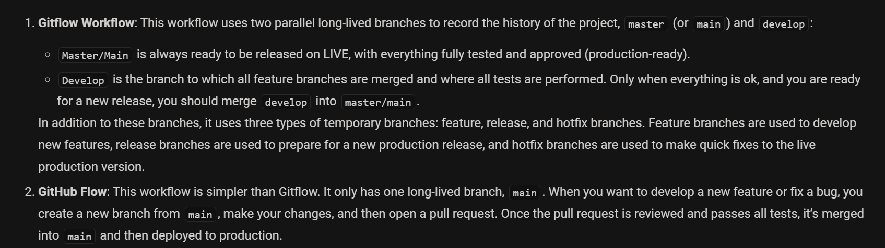
2. what
V1
V2
TBD

Slide 5
2.1 requirements
Requirement Description Sources
Parallel Development The strategy must allow multiple developers to work on different features or bug fixes simultaneously without interfering with each other's work.
This is often achieved by using separate branches for each task.[1][2][3] [1][2][3]
Code Stability and Quality A core requirement is to protect the main codebase from unstable or incomplete code.
The strategy should incorporate mechanisms like pull requests and code reviews to ensure that only tested and approved code is merged
into the main branch.[1] [1]
Release Management The chosen strategy should facilitate a smooth and organized release process. This includes the ability to prepare for a release, perform testing,
and manage different versions of the software in production.[4][5]
Some strategies use dedicated release branches for this purpose.[4][5] [4][5]
Hotfix Support When critical bugs are discovered in the production environment, the branching strategy must provide a clear and efficient process for creating and deploying
hotfixes without disrupting ongoing development.[4] [4]
Efficient Integration The strategy should encourage frequent integration of code to prevent large, complex merges and the associated "merge hell."[1]
Continuous integration (CI) practices are often a key component of this.[6][7] [1][6][7]
Clarity and Simplicity The branching model should be easy for the entire team to understand and follow.
A complicated strategy can lead to errors and slow down development.[1][5]
The choice may depend on the team's size and experience level.[1][6] [1][5][6]
Flexibility and Adaptability No single strategy is perfect for every project or team.
The chosen approach should be adaptable to the specific needs of the project and team, and it may even be a hybrid of different established strategies.[4][8] [4][8]
Support for Automation The strategy should align with and support automated testing and continuous integration/continuous delivery (CI/CD) pipelines.
This helps to ensure that every change is automatically tested before being merged.[1][6] [1][6]
Traceability It should be easy to track which code changes are associated with which features or bug fixes.
Naming conventions for branches that include issue or ticket numbers can help with this.[2] [2]

Slide 6
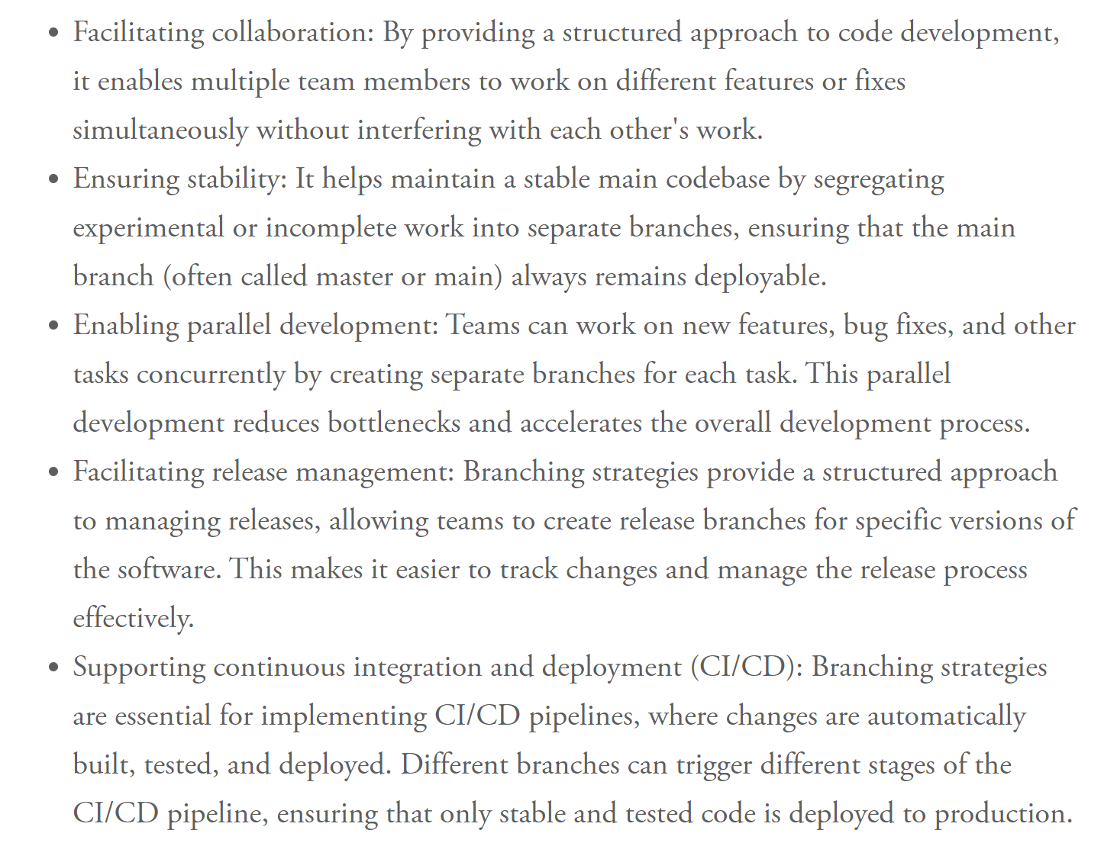
2.1.1 objectives
https://www.eisquare.co.uk/blogs/how-to-choose-your-branching-strategy

Slide 7
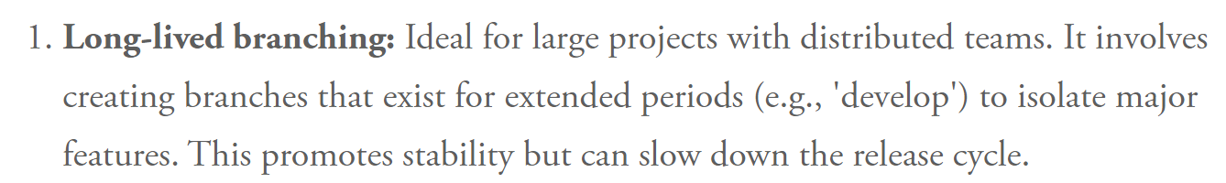
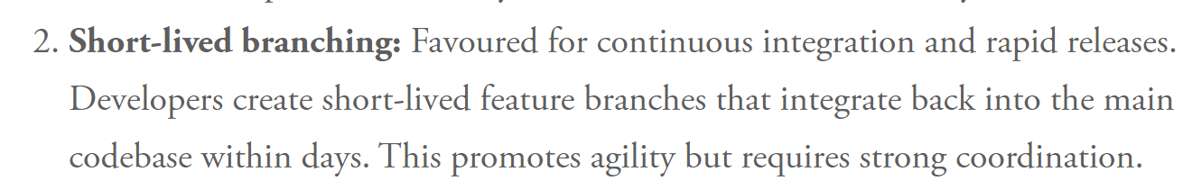
2.2 long lived
how to minimize
impossible

Slide 8
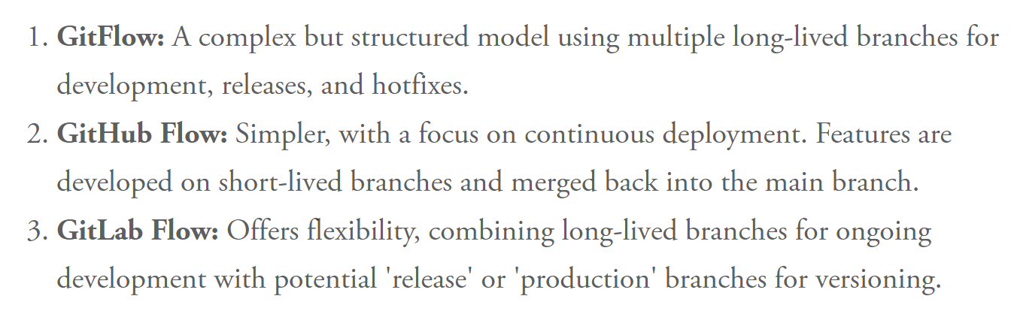
2.3 models
trunk based development
https://trunkbaseddevelopment.com/branch-for-release/

Slide 9
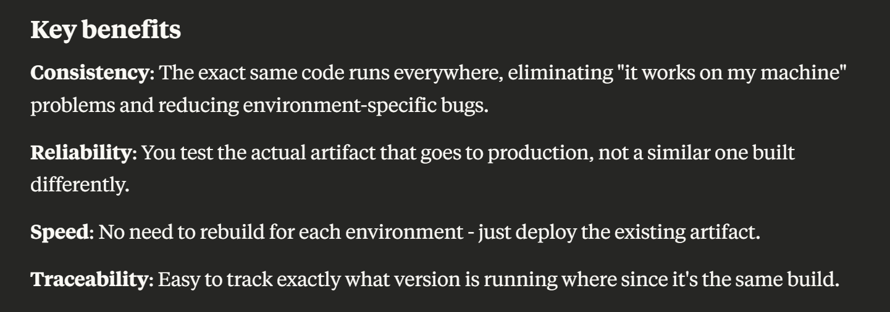
2.4 build once

Slide 10

3. versions
what
versions

Slide 11




4. flow
only once
major/minor cycle
bugfix
multiple
feature
develop
development
QA approval
staging
integration
v1.0.0
v1.1.0
acceptance
main
v1.0.0
v1.0.1
v1.0.2
v1.1.0
production
QA approval
multiple
hotfix
old version
for every
old version
QA approval
support
patch cycle
production
branch
branch
merge
cherry pick
commit
commit
deploy
environment

Slide 12
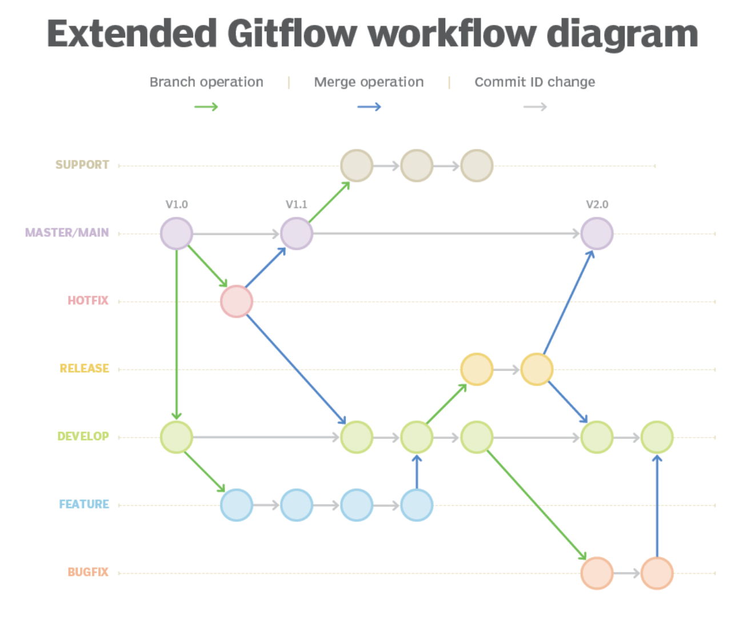
4.1 reference
A better Gitflow diagram with branches, merges and color
GitLab Flow

Slide 13
4.2 promote
1
Create feature (or bug-fix) branches off DEV
2
Promote a range of commits to staging
Do not squash
Azure will
fast-forward
or
create one merge commit
containing all SHA
X is the tip of DEV
QA wants all earlier commit
Open a PR
from DEV to STG
Complete PR
DEV
ahead count
goes to 0
QA decides:
everything up to commit X
on DEV
is good
X is not the tip of DEV
QA wants a subset
git checkout -b promote/X origin/staging
git merge --no-ff <commit-X>
3
Hotfixes

Slide 14
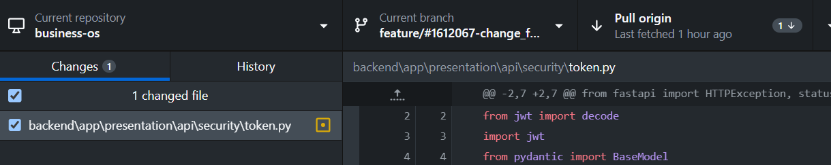
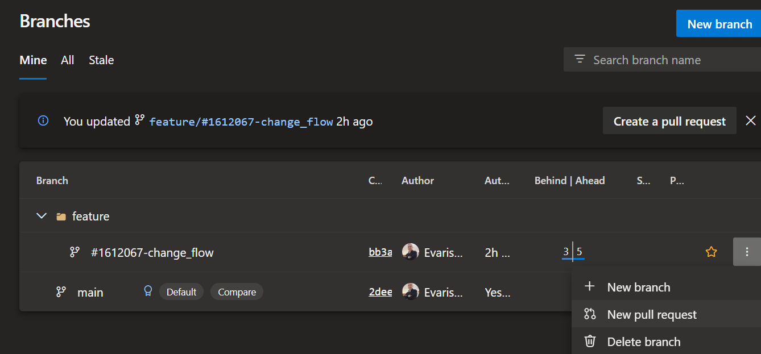
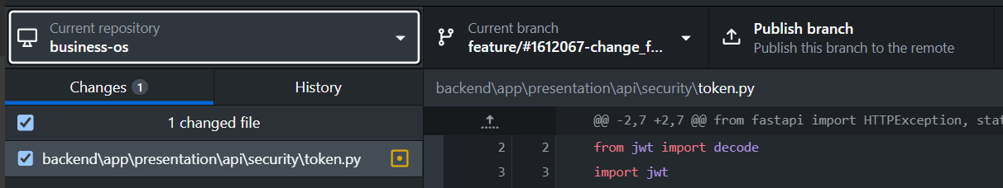
6. revert
1
git reset --soft HEAD~1
if pull origin
  it will
bring the last commit again
  because
I already pushed the commit
reset
reverts
  local
last commit
2
make a copy
  of
altered files
3
change repository;
go back to the last repository
4
delete
  local
branch
5
create
  new
branch
I think that
  if the new branch
has the same name as the last one
I cold have stashed the changes
  and then
get them again
6
copy
  files
back to new branch

Slide 15
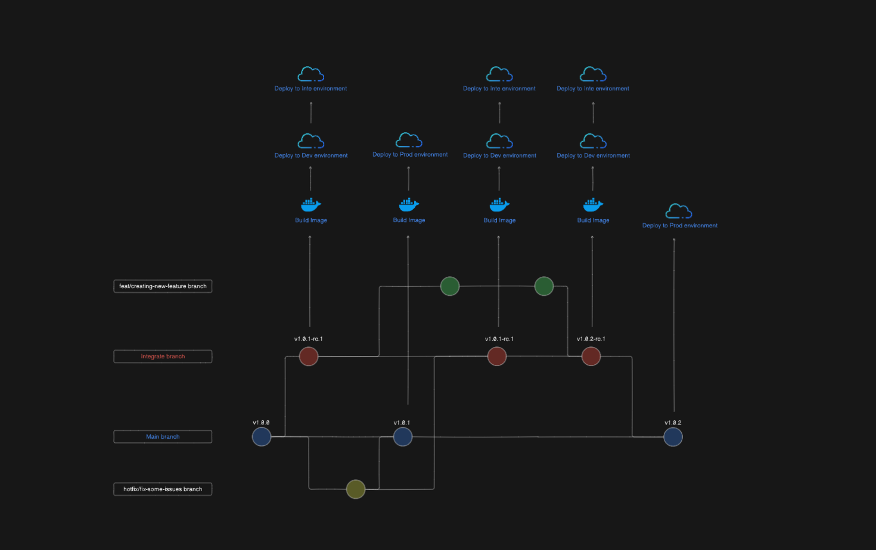

7. V2
Regression
Load/performance
Tests
collaboration
  scrum/agile
  structure approach
  simplicity
  no interference
  incomplete work
parallel development
  features
  bug fixes
  hot fixes
  high cohesion/low coupling
  architecture
QA
  tests
  PR
  Code reviews
  Regression
stability
  main
  local environments
  always deployable
release management
  versioning
  traceability
    track changes
    git history/versions
  build once
    settings management
  separation GIT from cloud env.
CI/CD
  easy
  every day
  automatic
simplicity/flexibility/agile/fast
  no bottlenecks
  react to change
NO PR
QA approval
V
V
automatic
panic button
regression
V
V
Repeated
V
automatic
V
V
settings
acceptance tests?
V
Alows
Revert
Increment version
(traceability)
PR multi:
for same feature
same version
tags
V
Final version
V
V
Merge
with or without
PR
V
automatic
panic button
regression
V
V
V
V
V
V
V
V
V
V
V
feature
No deployment
V
multiple
V
bugfix
PR:
Unit
Integration
Black duck
Sonar cloud
squash
Code review

Slide 16




Z. template
new project
ExecuteAsync
square post-it
download
  exe
download
  exe
why
A slash
  followed
by
  two consecutive asterisks
D:\A1_research\C2_c0dice\B1_jmeter\A1_install
functionalities
introduction
build-exe
entity framework plus
zig help
⊂
4
every key-frame
defines the operation
deploy

